Slide 1
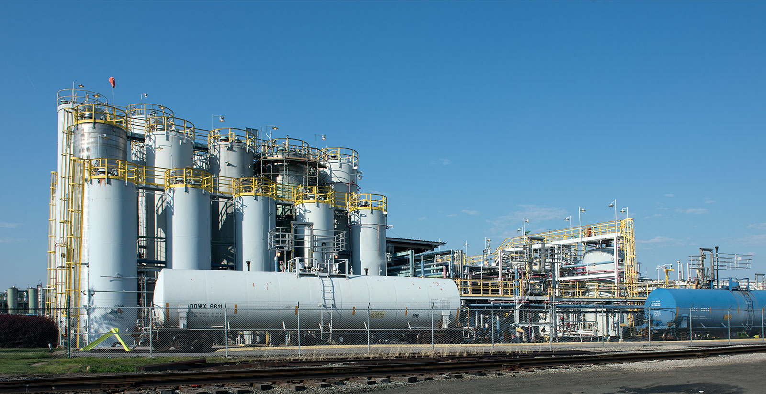

2015 – 2030
INDIA PPHP AND PPCP MARKET
FORECAST & OPPORTUNITIES
www.chemanalyst.com
MARKET INTELLIGENCE . CONSULTING

Slide 2
Table of Contents
S.No |  | Contents |  | Page No
1. | India Polypropylene Demand Market Outlook Historic and Forecast (2015 to 2030F)
 | 1.1. | India Polypropylene Capacity by Company
 |  | 1.1.1. | West India Polypropylene Capacity by Company 2015-2030
 |  | 1.1.2. | South India Polypropylene Capacity by Company 2015-2030
 |  | 1.1.3. | North India Polypropylene Capacity by Company 2015-2030
 |  | 1.1.4. | East India Polypropylene Capacity by Company 2015-2030
 | 1.2. | India Polypropylene Production by Company
 |  | 1.2.1. | West India Polypropylene Production by Company 2015-2030
 |  | 1.2.2. | South India Polypropylene Production by Company 2015-2030
 |  | 1.2.3. | North India Polypropylene Production by Company 2015-2030
 |  | 1.2.4. | East India Polypropylene Production by Company 2015-2030
 | 1.3. | India Polypropylene Homopolymer Demand Supply Gap Analysis
 |  | 1.3.1. | West India Polypropylene Homopolymer Production by Company 2015-2030 | 18
 |  | 1.3.2. | North India Polypropylene Homopolymer Production by Company 2015-2030 | 20
 |  | 1.3.3. | South India Polypropylene Homopolymer Production by Company 2015-2030 | 21
 |  | 1.3.4. | East India Polypropylene Homopolymer Production by Company 2015-2030 | 23
 | 1.4. | India Polypropylene Copolymer Demand Supply Gap Analysis
 |  | 1.4.1. | West India Polypropylene Copolymer Production by Company 2015-2030 | 25
 |  | 1.4.2. | North India Polypropylene Copolymer Production by Company 2015-2030 | 25
 |  | 1.4.3. | South India Polypropylene Copolymer Production by Company 2015-2030 | 25
 |  | 1.4.4. | East India Polypropylene Copolymer Production by Company 2015-2030 | 26

Slide 3
Table of Contents
S.No |  | Contents |  | Page No
 | 1.5. | India Polypropylene Homopolymer Market Share by Top 3 States
 |  | 1.5.1. | West India Polypropylene Homopolymer Market Share by Top 3 States, 2015-2030
 |  | 1.5.2. | North India Polypropylene Homopolymer Market Share by Top 3 States, 2015-2030
 |  | 1.5.3. | South India Polypropylene Homopolymer Market Share by Top 3 States, 2015-2030
 |  | 1.5.4. | East India Polypropylene Homopolymer Market Share by Top 3 States, 2015-2030
 | 1.6. | India Polypropylene Copolymer Market Share by Top 3 States
 |  | 1.6.1. | West India Polypropylene Copolymer Market Share by Top 3 States, 2015-2030
 |  | 1.6.2. | North India Polypropylene Copolymer Market Share by Top 3 States, 2015-2030
 |  | 1.6.3. | South India Polypropylene Copolymer Market Share by Top 3 States, 2015-2030
 |  | 1.6.4. | East India Polypropylene Copolymer Market Share by Top 3 States, 2015-2030
 | 1.7. | India Polypropylene Homopolymer Market Share by End Use
 |  | 1.7.1. | West India Polypropylene Homopolymer Market Share by End Use, 2015-2030 | 18
 |  | 1.7.2. | North India Polypropylene Homopolymer Market Share by End Use, 2015-2030 | 20
 |  | 1.7.3. | South India Polypropylene Homopolymer Market Share by End Use, 2015-2030 | 21
 |  | 1.7.4. | East India Polypropylene Homopolymer Market Share by End Use, 2015-2030 | 23
 | 1.8. | India Polypropylene Copolymer Market Share by End Use
 |  | 1.8.1. | West India Polypropylene Copolymer Market Share by End Use, 2015-2030 | 25
 |  | 1.8.2. | North India Polypropylene Copolymer Market Share by End Use, 2015-2030 | 25
 |  | 1.8.3. | South India Polypropylene Copolymer Market Share by End Use, 2015-2030 | 25
 |  | 1.8.4. | East India Polypropylene Copolymer Market Share by End Use, 2015-2030 | 26

Slide 4
Table of Contents
S.No |  | Contents |  | Page No
 | 1.9. | India Polypropylene Homopolymer Market Share by Grade
 |  | 1.9.1. | West India Polypropylene Homopolymer Market Share by Grade, 2015-2030
 |  | 1.9.2. | North India Polypropylene Homopolymer Market Share by Grade, 2015-2030
 |  | 1.9.3. | South India Polypropylene Homopolymer Market Share by Grade, 2015-2030
 |  | 1.9.4. | East India Polypropylene Homopolymer Market Share by Grade, 2015-2030
 | 1.10. | India Polypropylene Copolymer Market Share by Grade
 |  | 1.10.1. | West India Polypropylene Copolymer Market Share by Grade, 2015-2030
 |  | 1.10.2. | North India Polypropylene Copolymer Market Share by Grade, 2015-2030
 |  | 1.10.3. | South India Polypropylene Copolymer Market Share by Grade, 2015-2030
 |  | 1.10.4. | East India Polypropylene Copolymer Market Share by Grade, 2015-2030

Slide 5
List of Tables
S.No | Title | Page No
Table 1:

Slide 6
List of Figures
S.No | Title | Page No
Figure 1:

Slide 7
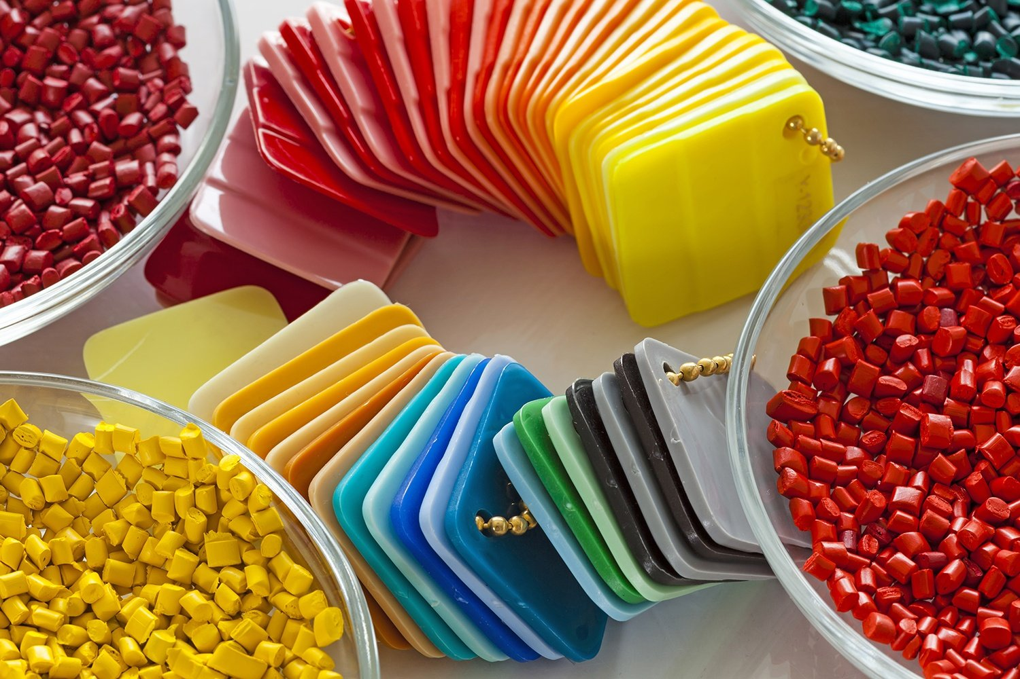
India PPHP & PPCP
Market Outlook

Slide 8
West and South India Polypropylene Capacity by Company, By Volume (Thousand Tonnes )
Table 1: West India Polypropylene Capacity, By Company, By Volume , 2015-2030F (Thousand Tonnes)
Company Name | Grade | Location | 2015 | 2020 | 2021 | 2022E | 2025F | 2030F
Reliance Industries Limited | PPHP and PPCP | Vadodara - Gujarat | 180 | 180 | 180 | 180 | 180 | 180
Reliance Industries Limited | PPHP and PPCP | Hazira - Gujarat | 440 | 440 | 440 | 440 | 440 | 440
Reliance Industries Limited | PPHP | Jamnagar - Gujarat | 2105 | 2105 | 2105 | 2105 | 2105 | 2105
Reliance Industries Limited | PPHP | Nagothane - Gujarat | 120 | 160 | 160 | 160 | 160 | 160
Indian Oil Corporation Limited | PPHP | Koyali - Gujarat | 0 | 0 | 0 | 0 | 500 | 500
ONGC Petro Additions Limited | PPHP and PPCP | Dahej - Gujarat | 0 | 340 | 340 | 340 | 340 | 340
Nayara Energy Limited | PPHP | Vadinar –Gujarat | 0 | 0 | 0 | 0 | 450 | 450
GAIL (India) Limited | PPHP | Usar - Maharashtra | 0 | 0 | 0 | 0 | 0 | 500
Table 2: South India Polypropylene Capacity, By Company, By Volume , 2015-2030F (Thousand Tonnes)
Company Name | Grade | Location | 2015 | 2020 | 2021 | 2022E | 2025F | 2030F
Mangalore Refinery & Petrochemicals Ltd | PPHP | Mangalore - Karnataka | 0 | 440 | 440 | 440 | 440 | 440

Slide 9
North and East India Polypropylene Capacity by Company, By Volume (Thousand Tonnes )
Table 3: North India Polypropylene Capacity, By Company, By Volume , 2015-2030F (Thousand Tonnes)
Company Name | Grade | Location | 2015 | 2020 | 2021 | 2022E | 2025F | 2030F
Indian Oil Corporation Limited | PPHP and PPCP | Panipat - Haryana | 600 | 600 | 760 | 760 | 760 | 760
HPCL-Mittal Energy Limited | PPHP and PPCP | Bathinda – Punjab | 440 | 467 | 467 | 967 | 967 | 967
GAIL (India) Limited | PPHP and PPCP | Pata – Uttar Pradesh | 0 | 0 | 0 | 0 | 60 | 60
Table 4: East India Polypropylene Capacity, By Company, By Volume , 2015-2030F (Thousand Tonnes)
Company Name | Grade | Location | 2015 | 2020 | 2021 | 2022E | 2025F | 2030F
Indian Oil Corporation Limited | PPHP | Paradip – Odissa | 0 | 700 | 700 | 700 | 700 | 700
Indian Oil Corporation Limited | PPHP | Barauni - Bihar | 0 | 0 | 0 | 0 | 200 | 200
Haldia Petrochemicals Limited | PPHP and PPCP | Haldia – West Bengal | 330 | 360 | 360 | 360 | 360 | 360
Brahmaputra Cracker and Polymers Limited | PPHP | Dibrugarh - Assam | 60 | 60 | 60 | 60 | 60 | 60

Slide 10
India Polypropylene Capacity by Company
Currently, there are six manufacturers of Polypropylene in the country, having a total manufacturing capacity of 6,012 thousand tonnes per annum in FY 2021. These are Reliance Industries Ltd. (RIL), Haldia Petrochemicals Ltd. (HPL), Indian Oil Corporation Ltd. (IOCL), HPCL- Mittal Energy Limited (HMEL) and Mangalore Refinery and Petrochemicals Limited.
Further, Nayara Energy Limited is setting up a new Polypropylene unit of 450 thousand tonnes per annum and the plant is expected to be commissioned by FY 2024, HPCL-Mittal Energy Limited is also coming up with a green field project at Bhatinda with a capacity of 500 thousand tonnes per annum, followed by GAIL (India) Limited with 60 and 500 thousand tonnes per annum of Polypropylene capacity at Pata unit and Usar Maharashtra. Moreover, Indian Oil Corporation Ltd. (IOCL) is also coming up with two new green field projects at Barauni and Koyali location with 200 and 500 thousand tonnes per annum respectively.

Slide 11
West and South India Polypropylene Production by Company, By Volume (Thousand Tonnes )
Table 5: West India Polypropylene Production, By Company, By Volume , 2015-2030F (Thousand Tonnes)
Company Name | Grade | Location | 2015 | 2020 | 2021 | 2022E | 2025F | 2030F
Reliance Industries Limited | PPHP and PPCP | Vadodara - Gujarat | 171 | 175 | 175 | 173 | 180 | 180
Reliance Industries Limited | PPHP and PPCP | Hazira - Gujarat | 421 | 430 | 431 | 426 | 440 | 440
Reliance Industries Limited | PPHP | Jamnagar - Gujarat | 2036 | 2082 | 2085 | 2057 | 2105 | 2105
Reliance Industries Limited | PPHP | Nagothane - Gujarat | 116 | 157 | 159 | 157 | 160 | 160
Indian Oil Corporation Limited | PPHP | Koyali - Gujarat | 0 | 0 | 0 | 0 | 150 | 390
ONGC Petro Additions Limited | PPHP and PPCP | Dahej - Gujarat | 0 | 315 | 313 | 308 | 320 | 333
Nayara Energy Limited | PPHP | Vadinar –Gujarat | 0 | 0 | 0 | 0 | 225 | 360
GAIL (India) Limited | PPHP | Usar - Maharashtra | 0 | 0 | 0 | 0 | 0 | 425
Table 6: South India Polypropylene Production, By Company, By Volume , 2015-2030F (Thousand Tonnes)
Company Name | Grade | Location | 2015 | 2020 | 2021 | 2022E | 2025F | 2030F
Mangalore Refinery & Petrochemicals Ltd | PPHP | Mangalore - Karnataka | 0 | 410 | 405 | 398 | 414 | 431

Slide 12
North and East India Polypropylene Production by Company, By Volume (Thousand Tonnes )
Table 7: North India Polypropylene Production, By Company, By Volume , 2015-2030F (Thousand Tonnes)
Company Name | Grade | Location | 2015 | 2020 | 2021 | 2022E | 2025F | 2030F
Indian Oil Corporation Limited | PPHP and PPCP | Panipat - Haryana | 625 | 580 | 582 | 591 | 684 | 713
HPCL-Mittal Energy Limited | PPHP and PPCP | Bathinda – Punjab | 324 | 445 | 441 | 890 | 909 | 948
GAIL (India) Limited | PPHP and PPCP | Pata – Uttar Pradesh | 0 | 0 | 0 | 0 | 30 | 51
Table 8: East India Polypropylene Production, By Company, By Volume , 2015-2030F (Thousand Tonnes)
Company Name | Grade | Location | 2015 | 2020 | 2021 | 2022E | 2025F | 2030F
Indian Oil Corporation Limited | PPHP | Paradip – Odissa | 0 | 282 | 390 | 388 | 605 | 681
Indian Oil Corporation Limited | PPHP | Barauni - Bihar | 0 | 0 | 0 | 0 | 30 | 160
Haldia Petrochemicals Limited | PPHP and PPCP | Haldia – West Bengal | 83 | 328 | 296 | 324 | 338 | 353
Brahmaputra Cracker and Polymers Limited | PPHP | Dibrugarh - Assam | 0 | 52 | 50 | 49 | 54 | 59

Slide 13
Polypropylene Homopolymer Demand Supply Gap Analysis
Table 9: West India Polypropylene Homopolymer Demand Supply Gap, By Volume, 2015-2030F (Thousand Tonnes)
 | 2015 | 2020 | 2021 | 2022E | 2023E | 2024E | 2025F | 2026F | 2027F | 2028F | 2029F | 2030F
Production | 2490 | 2825 | 2795 | 2671 | 2724 | 2892 | 3076 | 3379 | 3457 | 3659 | 3772 | 3859
Total Demand | 948 | 1507 | 1460 | 1579 | 1720 | 1882 | 2041 | 2214 | 2394 | 2583 | 2781 | 2980
Demand Supply Gap |  |  |  | 1092 | 1004 | 1010 | 1034 | 1165 | 1063 | 1076 | 990 | 879
Table 10: North India Polypropylene Homopolymer Demand Supply Gap, By Volume, 2015-2030F (Thousand Tonnes)
 | 2015 | 2020 | 2021 | 2022E | 2023E | 2024E | 2025F | 2026F | 2027F | 2028F | 2029F | 2030F
Production | 834 | 858 | 850 | 1275 | 1272 | 1323 | 1388 | 1387 | 1384 | 1434 | 1450 | 1462
Total Demand | 704 | 1043 | 982 | 1057 | 1148 | 1247 | 1349 | 1459 | 1572 | 1692 | 1819 | 1949
Demand Supply Gap |  |  |  | 217 | 123 | 76 | 39 | -72 | -189 | -258 | -369 | -487

Slide 14
Polypropylene Homopolymer Demand Supply Gap Analysis
Table 11: South India Polypropylene Homopolymer Demand Supply Gap, By Volume, 2015-2030F (Thousand Tonnes)
 | 2015 | 2020 | 2021 | 2022E | 2023E | 2024E | 2025F | 2026F | 2027F | 2028F | 2029F | 2030F
Production | 0 | 410 | 405 | 398 | 405 | 414 | 414 | 418 | 418 | 431 | 431 | 431
Total Demand | 658 | 1011 | 966 | 1021 | 1107 | 1211 | 1319 | 1434 | 1556 | 1686 | 1823 | 1961
Demand Supply Gap |  |  |  | -623 | -702 | -798 | -905 | -1016 | -1138 | -1254 | -1392 | -1530
Table 12: East India Polypropylene Homopolymer Demand Supply Gap, By Volume, 2015-2030F (Thousand Tonnes)
 | 2015 | 2020 | 2021 | 2022E | 2023E | 2024E | 2025F | 2026F | 2027F | 2028F | 2029F | 2030F
Production | 73 | 594 | 659 | 679 | 706 | 772 | 926 | 954 | 986 | 1017 | 1086 | 1146
Total Demand | 409 | 673 | 645 | 695 | 742 | 798 | 875 | 953 | 1039 | 1133 | 1233 | 1340
Demand Supply Gap |  |  |  | -16 | -35 | -26 | 51 | 0 | -52 | -116 | -147 | -194

Slide 15
Polypropylene Copolymer Demand Supply Gap Analysis
Table 13: West India Polypropylene Copolymer Demand Supply Gap, By Volume, 2015-2030F (Thousand Tonnes)
 | 2015 | 2020 | 2021 | 2022E | 2023E | 2024E | 2025F | 2026F | 2027F | 2028F | 2029F | 2030F
Production | 255 | 334 | 368 | 449 | 474 | 486 | 504 | 516 | 534 | 534 | 534 | 534
Total Demand | 338 | 475 | 448 | 469 | 508 | 548 | 591 | 637 | 686 | 737 | 791 | 847
Demand Supply Gap |  |  |  | -20 | -34 | -62 | -87 | -121 | -152 | -203 | -257 | -313
Table 14: North India Polypropylene Copolymer Demand Supply Gap, By Volume, 2015-2030F (Thousand Tonnes)
 | 2015 | 2020 | 2021 | 2022E | 2023E | 2024E | 2025F | 2026F | 2027F | 2028F | 2029F | 2030F
Production | 115 | 166 | 173 | 206 | 221 | 227 | 235 | 241 | 249 | 249 | 249 | 249
Total Demand | 204 | 340 | 341 | 370 | 407 | 444 | 482 | 522 | 565 | 610 | 657 | 707
Demand Supply Gap |  |  |  | -163 | -186 | -218 | -246 | -281 | -315 | -360 | -408 | -458

Slide 16
Polypropylene Copolymer Demand Supply Gap Analysis
Table 15: South India Polypropylene Copolymer Demand Supply Gap, By Volume, 2015-2030F (Thousand Tonnes)
 | 2015 | 2020 | 2021 | 2022E | 2023E | 2024E | 2025F | 2026F | 2027F | 2028F | 2029F | 2030F
Production | 0 | 0 | 0 | 0 | 0 | 0 | 0 | 0 | 0 | 0 | 0 | 0
Total Demand | 169 | 258 | 247 | 279 | 310 | 340 | 370 | 404 | 439 | 477 | 517 | 560
Demand Supply Gap |  |  |  | -279 | -310 | -340 | -370 | -404 | -439 | -477 | -517 | -560
Table 16: East India Polypropylene Copolymer Demand Supply Gap, By Volume, 2015-2030F (Thousand Tonnes)
 | 2015 | 2020 | 2021 | 2022E | 2023E | 2024E | 2025F | 2026F | 2027F | 2028F | 2029F | 2030F
Production | 10 | 68 | 77 | 82 | 95 | 97 | 101 | 103 | 107 | 107 | 107 | 107
Total Demand | 29 | 39 | 34 | 39 | 48 | 55 | 58 | 61 | 64 | 67 | 70 | 73
Demand Supply Gap |  |  |  | 43 | 47 | 42 | 43 | 42 | 43 | 40 | 37 | 34

Slide 17
India Polypropylene Homopolymer Market Share, By Volume, By Top 3 States
Figure 1: West India Polypropylene Homopolymer Market Share, By Top 3 States, By Volume (Thousand Tonnes), 2015–2030F
Others include Goa, Daman & Diu, etc
Source: ChemAnalyst
Figure 2: North India Polypropylene Homopolymer Market Share, By Top 3 States, By Volume (Thousand Tonnes), 2015–2030F
Others include Uttarakhand, Himachal Pradesh, etc.
Source: ChemAnalyst

Slide 18
India Polypropylene Homopolymer Market Share, By Top 3 States
Figure 3: South India Polypropylene Homopolymer Market Share, By Top 3 States, By Volume (Thousand Tonnes), 2015–2030F
Others include Kerala, Karnataka, etc
Source: ChemAnalyst
Figure 4: East India Polypropylene Homopolymer Market Share, By Top 3 States, By Volume (Thousand Tonnes), 2015–2030F
Others include Assam, Chhattisgarh, etc.
Source: ChemAnalyst

Slide 19
India Polypropylene Copolymer Market Share, By Top 3 States
Figure 5: West India Polypropylene Copolymer Market Share, By Top 3 States, By Volume (Thousand Tonnes), 2015–2030F
Others include Goa, Daman & Diu, etc
Source: ChemAnalyst
Figure 6: North India Polypropylene Copolymer Market Share, By Top 3 States, By Volume (Thousand Tonnes), 2015–2030F
Others include Uttarakhand, Himachal Pradesh, etc.
Source: ChemAnalyst
Year depicts the fiscal year ending in the month of March of that year.
2020 – April 2019-March 2020

Slide 20
India Polypropylene Copolymer Market Share, By Top 3 States
Figure 7: South India Polypropylene Copolymer Market Share, By Top 3 States, By Volume (Thousand Tonnes), 2015–2030F
Others include Kerala, Karnataka, etc
Source: ChemAnalyst
Figure 8: East India Polypropylene Copolymer Market Share, By Top 3 States, By Volume (Thousand Tonnes), 2015–2030F
Others include Assam, Chhattisgarh, etc.
Source: ChemAnalyst

Slide 21
India Polypropylene Homopolymer Market Share, By End Use
Figure 9: West India Polypropylene Homopolymer Market Share, By End Use, By Volume (Thousand Tonnes), 2015–2030F
Others include, etc
Source: ChemAnalyst
Figure 10: North India Polypropylene Homopolymer Market Share, By End Use, By Volume (Thousand Tonnes), 2015–2030F
Others include, etc.
Source: ChemAnalyst

Slide 22
India Polypropylene Homopolymer Market Share, By End Use
Figure 11: South India Polypropylene Homopolymer Market Share, By End Use, By Volume (Thousand Tonnes), 2015–2030F
Others include, etc
Source: ChemAnalyst
Figure 12: East India Polypropylene Homopolymer Market Share, By End Use, By Volume (Thousand Tonnes), 2015–2030F
Others include, etc.
Source: ChemAnalyst

Slide 23
India Polypropylene Copolymer Market Share, By End Use
Figure 13: West India Polypropylene Copolymer Market Share, By End Use, By Volume (Thousand Tonnes), 2015–2030F
Others include, etc
Source: ChemAnalyst
Figure 14: North India Polypropylene Copolymer Market Share, By End Use, By Volume (Thousand Tonnes), 2015–2030F
Others include, etc.
Source: ChemAnalyst

Slide 24
India Polypropylene Copolymer Market Share, By End Use
Figure 15: South India Polypropylene Copolymer Market Share, By End Use, By Volume (Thousand Tonnes), 2015–2030F
Others include, etc
Source: ChemAnalyst
Figure 16: East India Polypropylene Copolymer Market Share, By End Use, By Volume (Thousand Tonnes), 2015–2030F
Others include, etc.
Source: ChemAnalyst

Slide 25
India Polypropylene Homopolymer Market Share, By Grade
Figure 17: West India Polypropylene Homopolymer Market Share, By Grade, By Volume (Thousand Tonnes), 2015–2030F
Others include, etc
Source: ChemAnalyst
Figure 18: North India Polypropylene Homopolymer Market Share, By Grade, By Volume (Thousand Tonnes), 2015–2030F
Others include, etc.
Source: ChemAnalyst

Slide 26
India Polypropylene Homopolymer Market Share, By Grade
Figure 19: South India Polypropylene Homopolymer Market Share, By Grade, By Volume (Thousand Tonnes), 2015–2030F
Others include, etc
Source: ChemAnalyst
Figure 20: East India Polypropylene Homopolymer Market Share, By Grade, By Volume (Thousand Tonnes), 2015–2030F
Others include, etc.
Source: ChemAnalyst

Slide 27
India Polypropylene Copolymer Market Share, By Grade
Figure 21: West India Polypropylene Copolymer Market Share, By Grade, By Volume (Thousand Tonnes), 2015–2030F
Others include, etc
Source: ChemAnalyst
Figure 22: North India Polypropylene Copolymer Market Share, By Grade, By Volume (Thousand Tonnes), 2015–2030F
Others include, etc.
Source: ChemAnalyst

Slide 28
India Polypropylene Copolymer Market Share, By Grade
Figure 23: South India Polypropylene Copolymer Market Share, By Grade By Volume (Thousand Tonnes), 2015–2030F
Others include, etc
Source: ChemAnalyst
Figure 24: East India Polypropylene Copolymer Market Share, By Grade, By Volume (Thousand Tonnes), 2015–2030F
Others include, etc.
Source: ChemAnalyst

Slide 29
Recommendation
As per the current market dynamics of Polypropylene west region has surplus capacity to produce Polypropylene and the total demand is expected to reach 3827 thousand tonnes per annum by FY 2030 with a CAGR of 8.13%. As of now West region hold 3085 thousand tonnes per annum of capacity which is expected to reach 4535 thousand tonnes per annum. West region is going to have surplus of capacity than the estimated demand for the forecast period.
North region hold around 1151 thousand tonnes of capacity in FY 2021 and estimated to reach 1646 by FY 2030. The demand of Polypropylene in north region is estimated to reach 2656 thousand tonnes per annum by FY 2030. The region is expected to have a deficit of 777 thousand tonnes of Polypropylene by FY 2030.
East Region hold 1120 thousand tonnes of capacity which is anticipated to reach 1320 thousand tonnes after commissioning of IOCL – Barauni PP capacity. The demand in eastern region of the country was 678 thousand tonnes in FY 2021 which is anticipated to reach 1412 thousand tonnes by FY 2030.
South region hold 440 thousand tonnes of capacity, Mangalore Refinery & Petrochemicals Limited (MRPL) is the only company in the southern region to produce Polypropylene and the demand of Polypropylene was 1212 thousand tonnes in FY 2021 is anticipated to reach 2520 thousand tonnes by FY 2030. Thus, creating an opportunity for new entrant to enter into the market. The region is expected to grow with fastest CAGR of 8.62 %. Many new automotive manufactures are planning to establish their manufacturing facility in the region which will propel the demand of Polypropylene Copolymer in the region. Further, MRPL only produce Polypropylene Homo polymer grade. Additionally due to proximity to ports the company will have an advantage to export the product. Due to increase in demand supply gap in the southern region of the country the feasibility for setting up a green field project of Polypropylene will be profitable.

